Slide 1
TEAM- 60
CODE QUEENS

Slide 2


HERO OF JALDHAARA
To oversee financial operations, secure funding, ensure regulatory compliance, manage donor relationships, and optimize resources to support the NGO's mission..
WELL IT’S ME ..
THE USER

Slide 3


GOT SOME PROBLEMS
1
Knowledge Gap- updated list
2
Regulatory Compliance
s Start!
3
Finding who is interested?
4
which WASH sector?

Slide 4
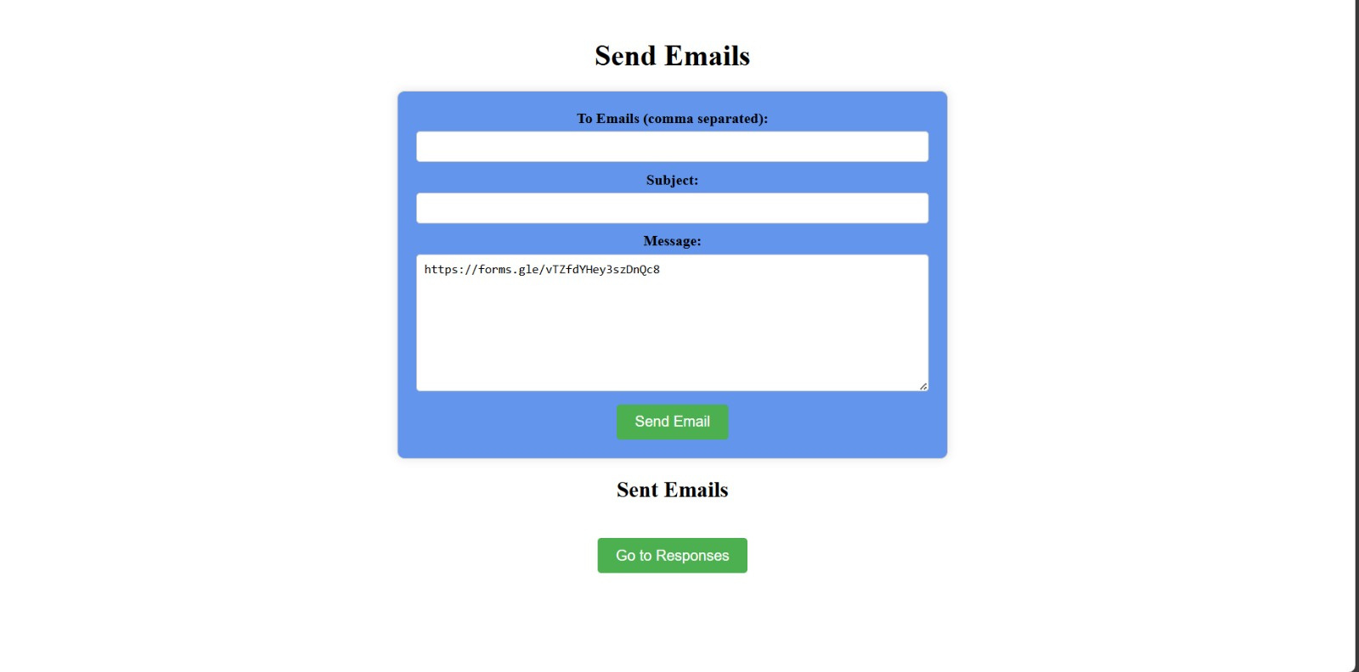
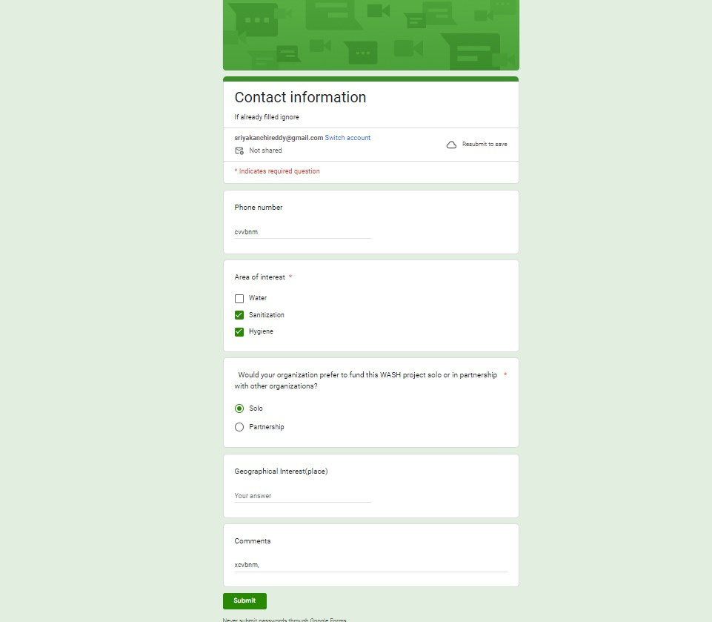

solution
organization outreach form

Slide 5
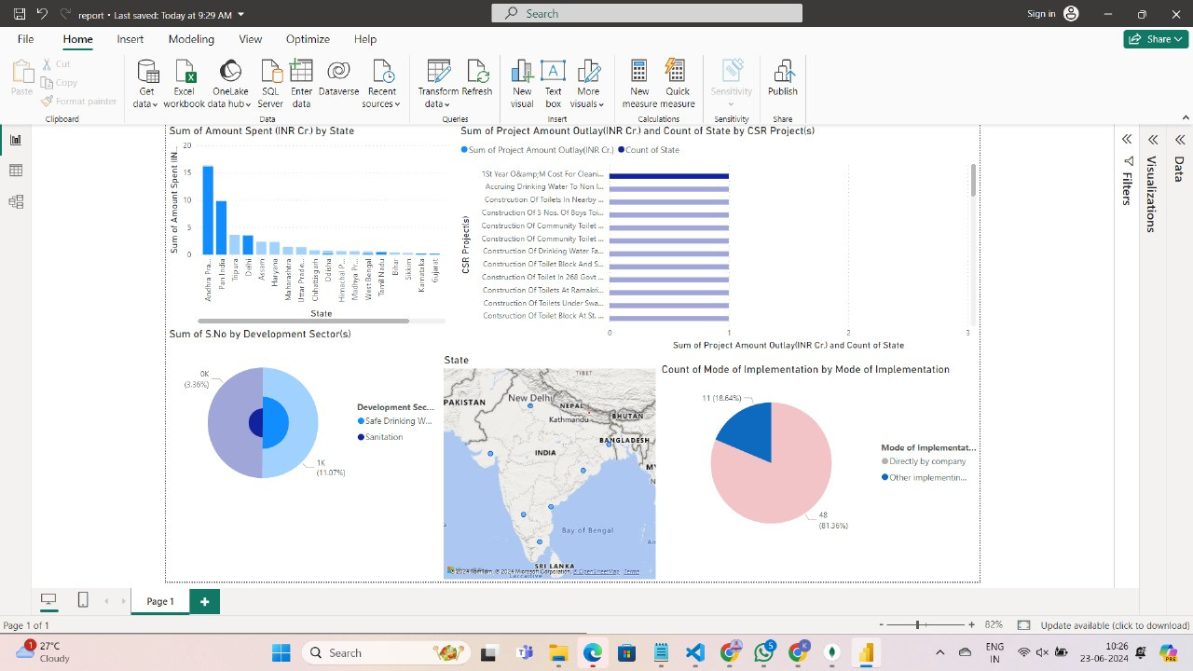
solution
Data Visualization

Slide 6
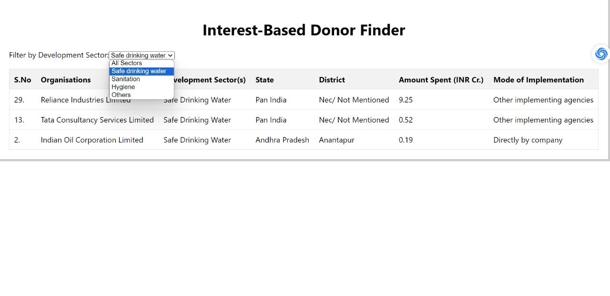
solution
Area of Interest

Slide 7

KEY FEATURES
1) Latest official donor list -
a) Alinged CSR guidelines
b) geographical interest
c) WASH sectors
d) Method of Execution
2) Outreach and follow up with selected donor
3) Data Visualization -
a) project -related trends and patterns
b)amount outlay vs amount spent
c) Distribution across development sector

Slide 8
Ideas for future enhancement
1) Automated IVR
2) Income Tax Invoice
3) Passionate Donor

Slide 9
THANK YOU FROM TEAM- 60

